Slide 1
Starting out with Project Q
For use with students

Slide 2
Contents
What is Project Q?
Features
Home page
Production log
Message board
Journal
Course resources
Student Registration

Slide 3
What is Project Q?
Everything Project Qualification related is stored in the one system
On-line, access anywhere https://my.projectq.co
Maintain your Production Log online
Keep a journal/diary/blog of your progress
Store resources, research and links
Communicate with your supervisor

Slide 4
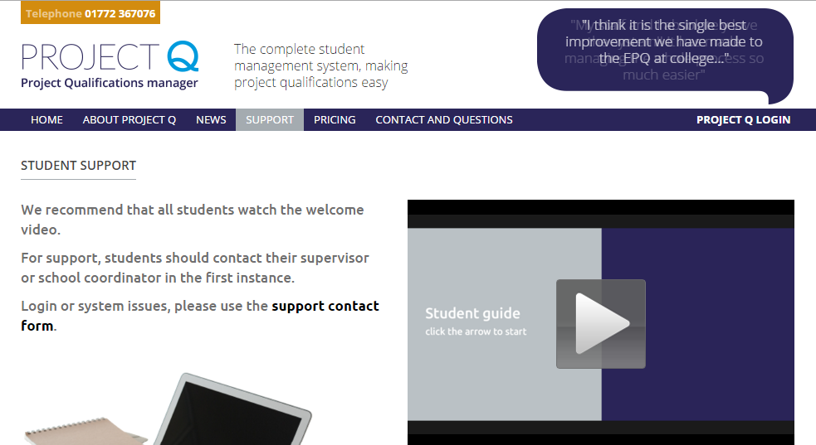
Video Guide
Video Guide for students
http://www.projectq.co/support/students

Slide 5
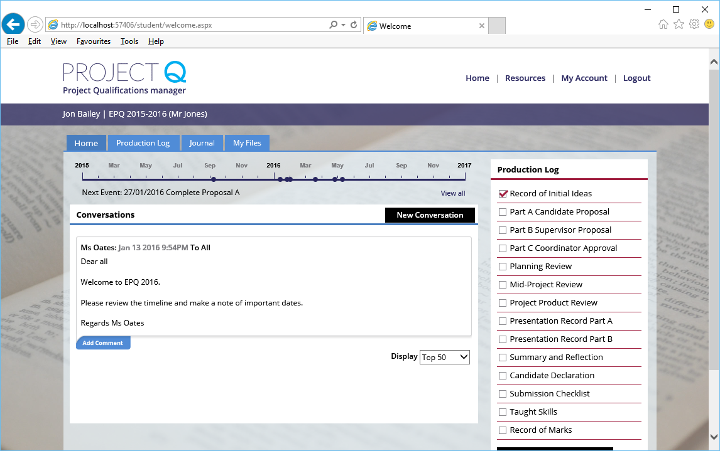
Home page
Timeline; never miss a deadline! (if set by your coordinator)
Message board and Production log status

Slide 6
Production Log
The log is the official record of your journey through the project
Mostly completed by you but signed off by your supervisor
This is submitted to the exam board and is assessed as part of your project
Complete the sections on time. Meet with your supervisor ahead of the deadline
Refer back to your journal to assist you with the reflective sections

Slide 7
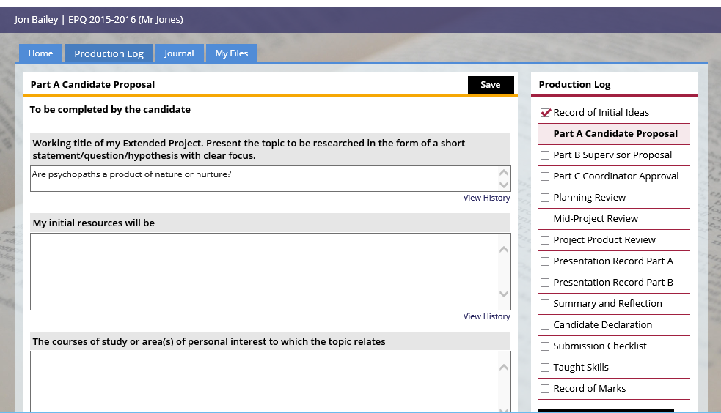
Production Log
Add plenty of depth/detail to your work
Sections with a tick are locked by your supervisor
Always spell check

Slide 8
Message board
Shows messages that are related to you only
Send a message to your supervisor or other teachers
An email is sent only when a new conversation is created
A file can be attached

Slide 9
Journal
Use the optional journal feature to keeping a track of your progress
Make an entry each time you work on your Project
Use it to
Record research, journals, articles, images
Note your thoughts, frustrations and “Eureka” moments
Your supervisor can access and make comments
Tag your entries to provide quick recall to research or ideas you have had

Slide 10
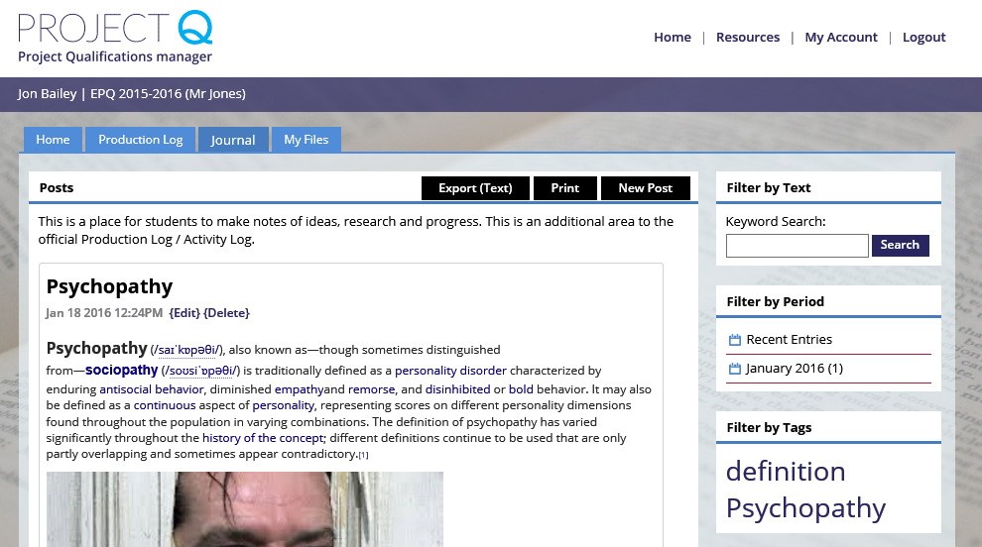
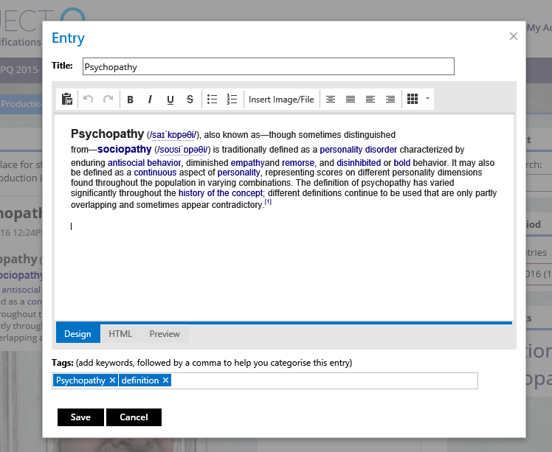
Journal

Slide 11
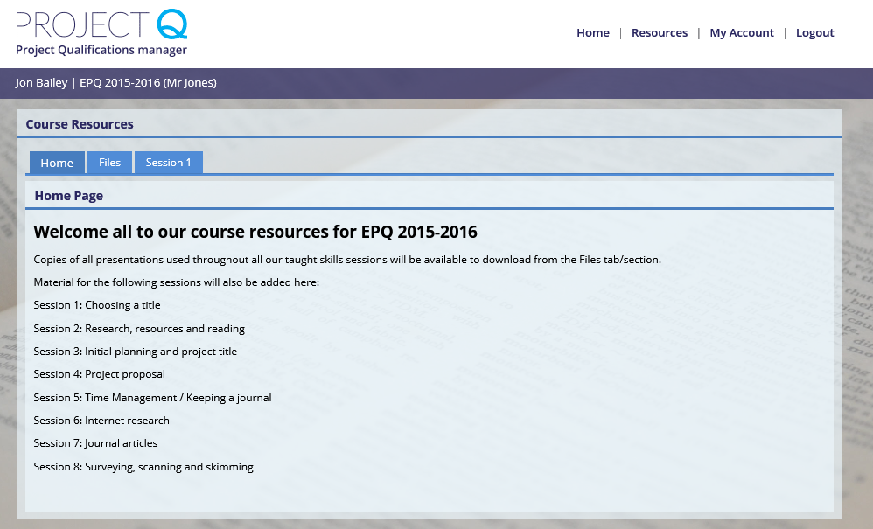
Course resources
Check the resources section for links, files and important information regarding your course (if set by your supervisor/coordinator)

Slide 12
Time to register
Type into your Internet address bar (not Google!) https://my.projectq.co
Click on Register
Enter course ref XXX, Enter course code XXXXXX
Register
Teacher: To get the course ref & code, login as coordinator, click Switch Course, click Self register next to the course you wish students to register with.

Slide 13
First steps
You may not be assigned to a supervisor initially – this won’t stop you being able to carry on with your work
Start by creating a journal entry to discuss your thoughts and ideas for a Project

Slide 14
https://my.projectq.co

